Slide 1


Slide 2

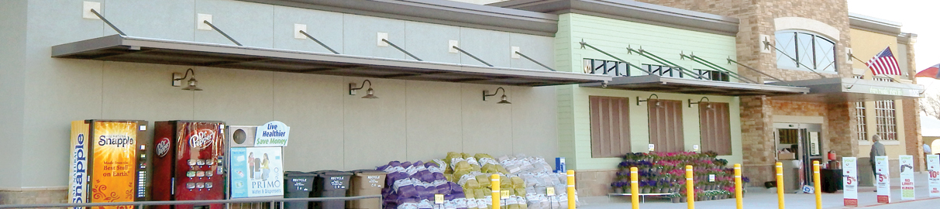

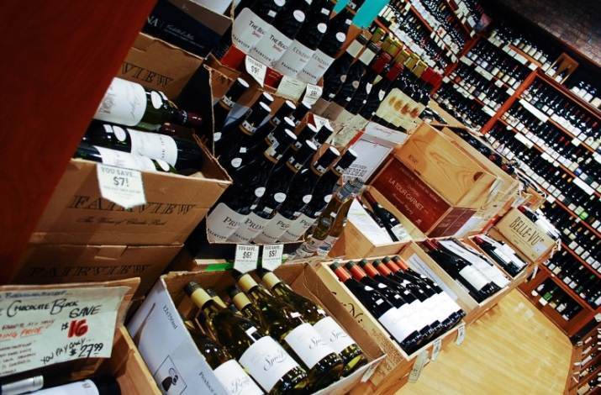

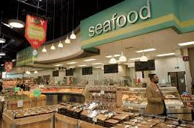
www.thefoodpartners.com
Mergers & Acquisitions
Presented by The Food Partners
November 2019

Slide 3
Retail Landscape
Amazon ups online grocery ante with free Amazon Fresh
Kroger, not Walmart, is Amazon’s toughest grocery price rival
Kroger is dismantling its site location department and consolidating the majority of its real estate department to focus on their on-line business segment
Amazon reported a 1% decline in retail grocery store sales and a 21% increase in on-line grocery sales for the last quarter
The amount of capital that will invested by the major supermarket chains during the next 5 years in their e-commerce platforms will be billions of dollars
3

Slide 4
EBITDA Margins
Comparable Store Sales
- Source: Capital IQ, company filings
- As of 11/4/2019
- Comparable store sales for latest quarter over quarter
4

Slide 5
Stock Price and Enterprise Value to EBITDA of Select Publicly Traded Retailers Over Time
- Source: Capital IQ, Yahoo Finance
[1] 20 day average
5

Slide 6
Bankruptcies
Number of Supermarket Bankruptcies by Year
Supermarket Bankruptcy Detail
  The number of supermarket bankruptcies has been consistent over the past several years
  Since 2010, 6 companies with over 100 stores have filed for bankruptcy
    A&P, Fresh & Easy, Haggen, Sears (Kmart), Southeastern Grocers and Tops
  The average chain is 17 stores (for bankruptcies under 100 stores)
- Sources: The Food Partners, Capital IQ, news releases
6

Slide 7
Transactions
Mergers and Acquisitions
Portfolio Versus Corporate Transactions
  The number of stores sold annually since 2010 have fluctuated between approximately 400 and 1,000 (excluding the Albertson’s, Safeway and Delhaize acquisitions in 2013, 2014 and 2015, respectively)
Stores Sold
Average Stores per Transaction
- Source: Company reports, news articles, The Food Partners
- Includes announced but not yet closed transactions
- >500 store transactions: Albertson’s, Safeway and Delhaize acquisitions in 2013, 2014 and 2015, respectively
7

Slide 8
Outlook for M&A
  Mega mergers are over
  Albertsons will not make a large store acquisition until they complete their IPO
  Kroger is on the sideline and is expected to remain relatively inactive
  Ahold is very active in the space with multiple transactions and will continue to do so
  It is highly unlikely any regional chain will sell in the near term with the exception of Winn Dixie
  Consolidation of independents will continue at its current pace
8

Slide 9
Strategic Priority for Manufactures and Distributors
  2019 supply chain benchmarking study
    Item count has grown by 42% over the last 4 years, an average of 9,000 per year
    58% of participates in the survey operate at capacity
    16% were over 100% of capacity
  Investing in more distribution capacity, even if it is automated, is not the solution
  Reinventing the supply chain is required to provide independent retailers the ability to effectively compete
  Both manufactures and distributors need to cooperate to realign the distribution network
  Consolidation at distribution is required to take overhead out of the system
9

Slide 10
Strategic Priories for Retails
  Focus on the younger consumer with children
  Self-checkout has come of age – take advantage of it given the shortage of labor
  Retailers that have viable retail stores that they don’t invest in them do not get better with age
  There is a place in the new world order for independent retailers
10

